Slide 1

OPC UA
OPC UA Server generated from model with MQTT client
Wolfgang Hottgenroth
2016-06-09

Slide 2


Title here again in Arial 24 max. one line
Topic here, Arial 20
Topic here, max. one line
Topic here, use boldness for marking
Topic here, move the triangle for marking
Topic here, do not use more than 10 topics
Topic here, keep it simple
Agenda

Slide 3
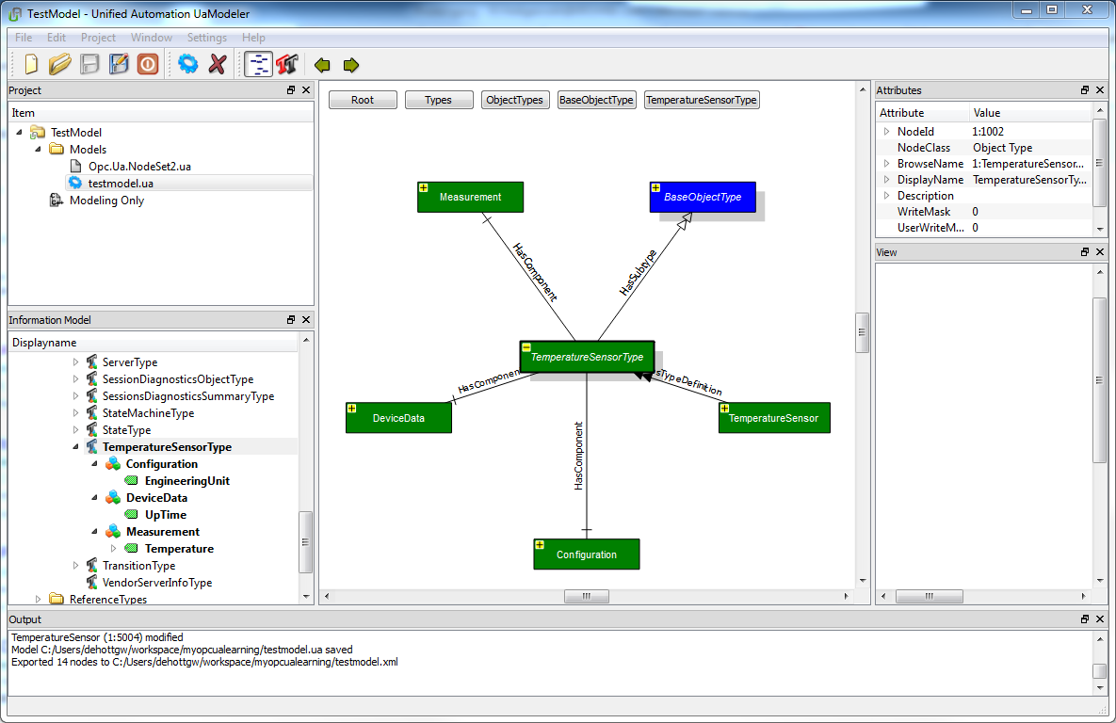
OPC UA
Creation of Model
  Model created with UaModeler (Unified Automation GmbH)
  First, a “type” has to
  be created

Slide 4
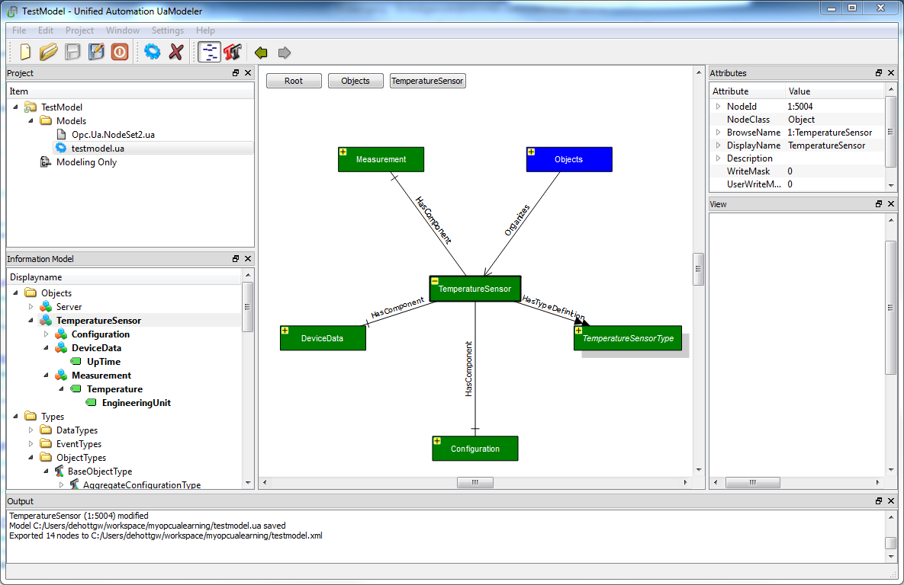
OPC UA
Creation of Model
  Second, based on that type an instance has to be created

Slide 5
OPC UA
Creation of Model
Can be easily created
using KDDB Generator
Required structure
information is available
in KDDB
  Model exported into XML format (OPC UA XML Schema)
<UANodeSet xmlns:xsi="http://www.w3.org/2001/XMLSchema-instance" xmlns:uax="http://opcfoundation.org/UA/2008/02/Types.xsd" xmlns="http://opcfoundation.org/UA/2011/03/UANodeSet.xsd" xmlns:s1="http://krohnegroup.com/TestModel/Types.xsd" xmlns:xsd="http://www.w3.org/2001/XMLSchema">
<NamespaceUris>
<Uri>http://krohnegroup.com/TestModel/</Uri>
</NamespaceUris>
[…]
<UAObjectType NodeId="ns=1;i=1002" BrowseName="1:TemperatureSensorType">
<DisplayName>TemperatureSensorType</DisplayName>
<References>
<Reference ReferenceType="HasComponent">ns=1;i=5001</Reference>
<Reference ReferenceType="HasComponent">ns=1;i=5006</Reference>
<Reference ReferenceType="HasComponent">ns=1;i=5002</Reference>
<Reference ReferenceType="HasSubtype" IsForward="false">i=58</Reference>
</References>
</UAObjectType>
<UAObject ParentNodeId="ns=1;i=1002" NodeId="ns=1;i=5001" BrowseName="1:Configuration">
<DisplayName>Configuration</DisplayName>
<References>
<Reference ReferenceType="HasTypeDefinition">i=58</Reference>
<Reference ReferenceType="HasComponent" IsForward="false">ns=1;i=1002</Reference>
<Reference ReferenceType="HasComponent">ns=1;i=6001</Reference>
<Reference ReferenceType="HasModellingRule">i=78</Reference>
</References>
</UAObject>
[…]

Slide 6

OPC UA
Generation of Code
  open62541 (Open Source Stack for Server and Client) provides tool to generate C-code from XML
TestModel.c: testmodel.xml
./tools/pyUANamespace/generate_open62541CCode.py \
tools/schema/namespace0/Opc.Ua.NodeSet2.xml $^ TestModel
TestModel.h: TestModel.c
myTestModelServer.o: myTestModelServer.c TestModel.h
myTestModelServer: myTestModelServer.o TestModel.o
$(CC) -o $@ $(CFLAGS) $(LDFLAGS) $^ $(LIBS) -lmosquitto .c.o: $(CC) $(CFLAGS) -c $<
  Namespace 0 of OPC UA needs to be created into C-code too, since it contains basic definitions required in specific model
  Created C-file is large:

Slide 7
OPC UA
Server Code - Initialization
  Server code is rather simple
int main(int argc, char** argv) {
signal(SIGINT, stopHandler); /* catches ctrl-c */
/* initialize the server */
UA_ServerConfig config = UA_ServerConfig_standard;
UA_ServerNetworkLayer nl =
UA_ServerNetworkLayerTCP(UA_ConnectionConfig_standard, 16664);
config.networkLayers = &nl;
config.networkLayersSize = 1;
UA_Server *server = UA_Server_new(config);

Slide 8
OPC UA
Server Code – Loading and “bonding” the model
uint32_t upTime = 0;
static UA_StatusCode readInteger(void *handle, const UA_NodeId nodeid,
UA_Boolean sourceTimeStamp, const UA_NumericRange *range, UA_DataValue *dataValue) {
dataValue->hasValue = true;
UA_Variant_setScalarCopy(&dataValue->value, handle, &UA_TYPES[UA_TYPES_INT32]);
return UA_STATUSCODE_GOOD;
}
Main() continued:
TestModel(server);
UA_DataSource uptimeDataSource = (UA_DataSource) {
.handle = &upTime, .read = readInteger, .write = 0}; UA_Server_setVariableNode_dataSource(server, UA_NODEID_NUMERIC(2, 6006),
uptimeDataSource);
UA_DataSource measuredTemperatureDataSource = (UA_DataSource) {
.handle = &measuredTemperature, .read = readDouble, .write = 0}; UA_Server_setVariableNode_dataSource(server, UA_NODEID_NUMERIC(2, 6004),
measuredTemperatureDataSource);

Slide 9
OPC UA
Server Code – Running the server
Main() continued:
UA_StatusCode retval = UA_Server_run_startup(server);
if (retval == UA_STATUSCODE_GOOD) {
while (running == true) {
upTime = time(0);
measuredTemperature += 0.25; // dummy value
uint16_t canWait = 0;
canWait = UA_Server_run_iterate(server, 0);
struct timeval timeout = { .tv_sec = 0, .tv_usec = canWait * 1000 };
select(0, 0, 0, 0, &timeout);
}
}

Slide 10
Thank you for your attention!

